Slide 1


LETOURNEAU UNIVERSITY EETC 3433 ELECTRICAL MACHINERY AND CONTROLS for JLNU Fall Semester 2024 Lesson 9: 20241107 Thu
By Judy WS Wong

Slide 2
Agenda
Before Break
PLC knowledge
After Break
Other Controls
Briefing on group Project

Slide 3
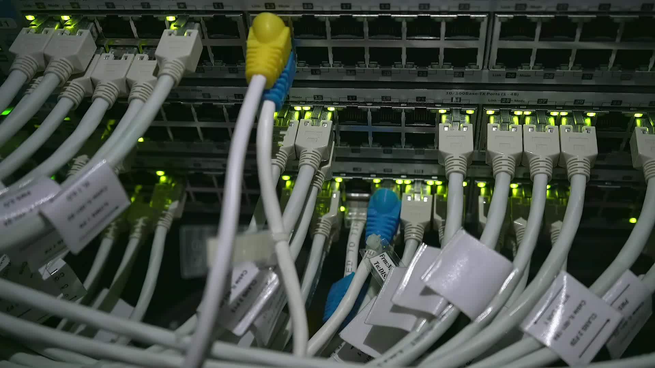
Control – PLC / GPIO

Slide 4
https://www.bilibili.com/video/BV1wb421n7oT/
https://www.bilibili.com/video/BV1PV411C7in/
Video – understanding of PLC

Slide 5
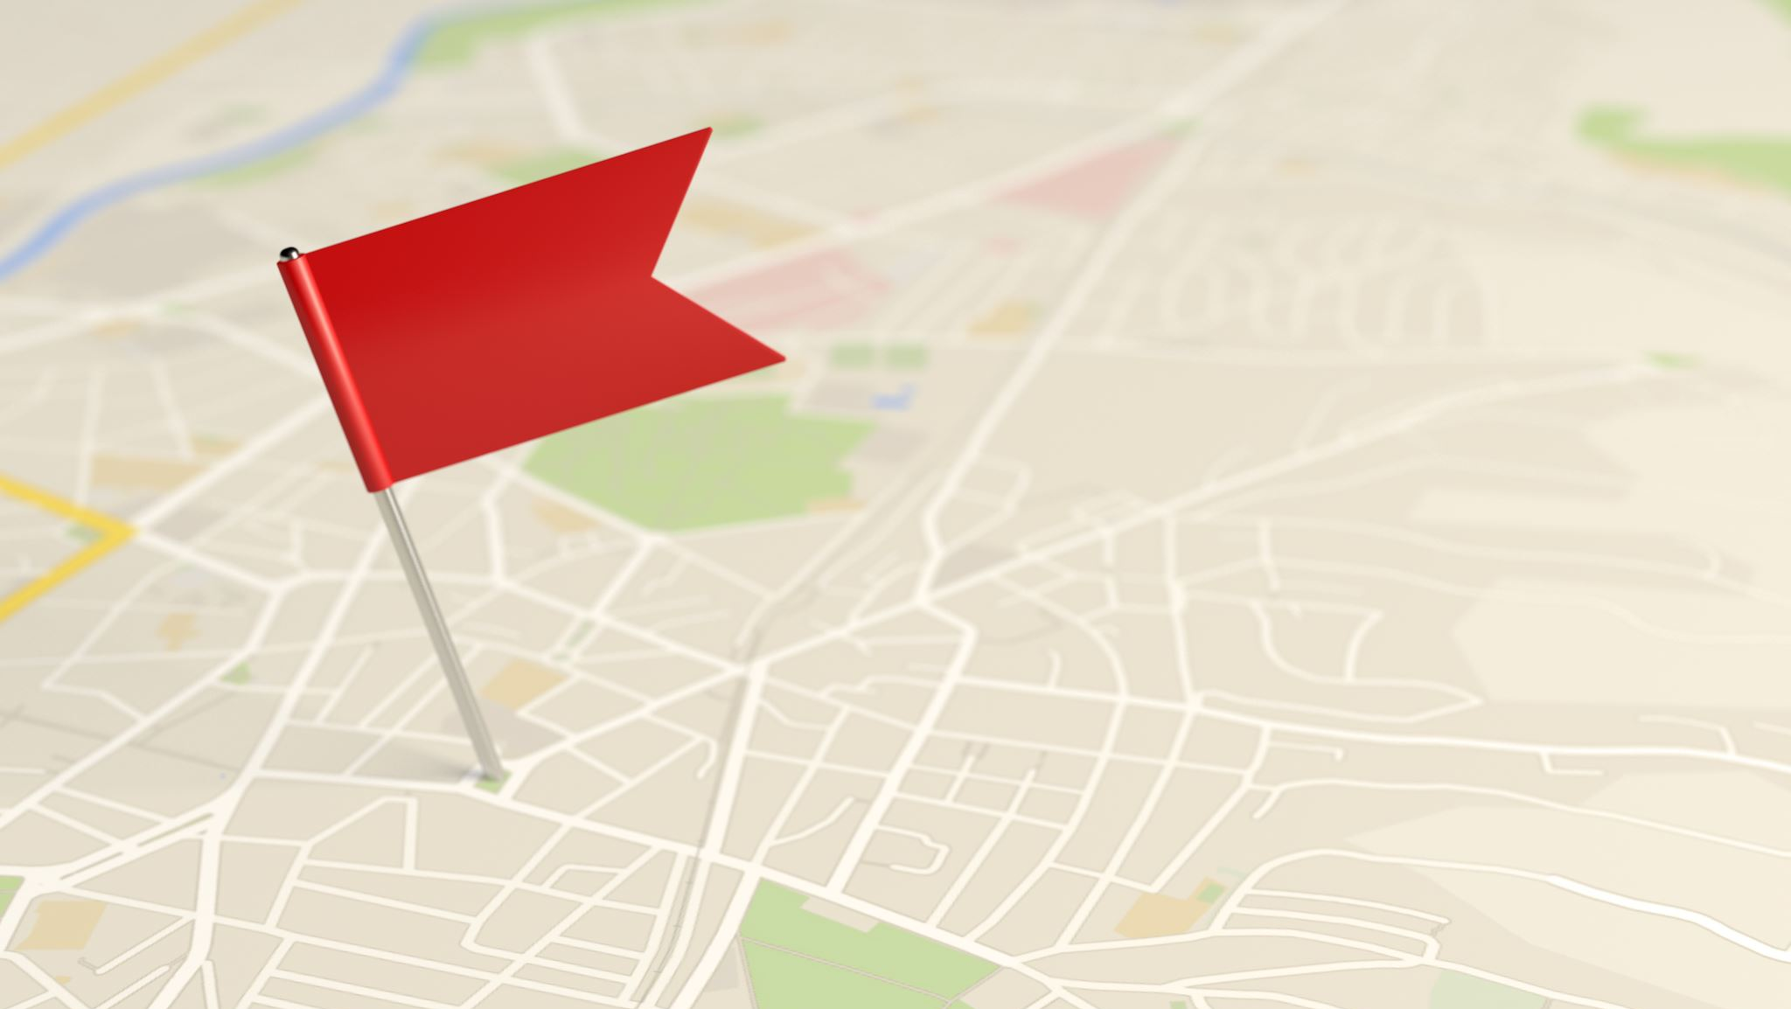
https://www.bilibili.com/video/BV1Zp411o76x/
Video – Rpi vs Arduino

Slide 6
GPIO – General Purpose Input / Output

Slide 7

https://www.pdfsupply.com/blog/index.php/2021/12/06/raspberry-pi-vs-plc/
Read the above to understand between PLC & RPri

Slide 8

Exercise: what are the modern controlling devices we have? (discussion later)
https://miro.com/app/board/uXjVLNTuDhY=/

Slide 9
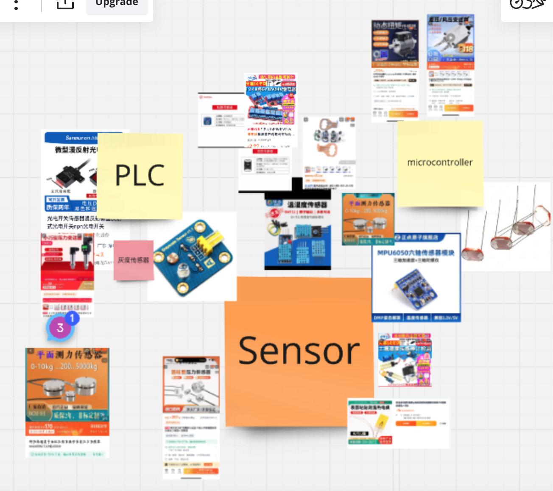

Slide 10
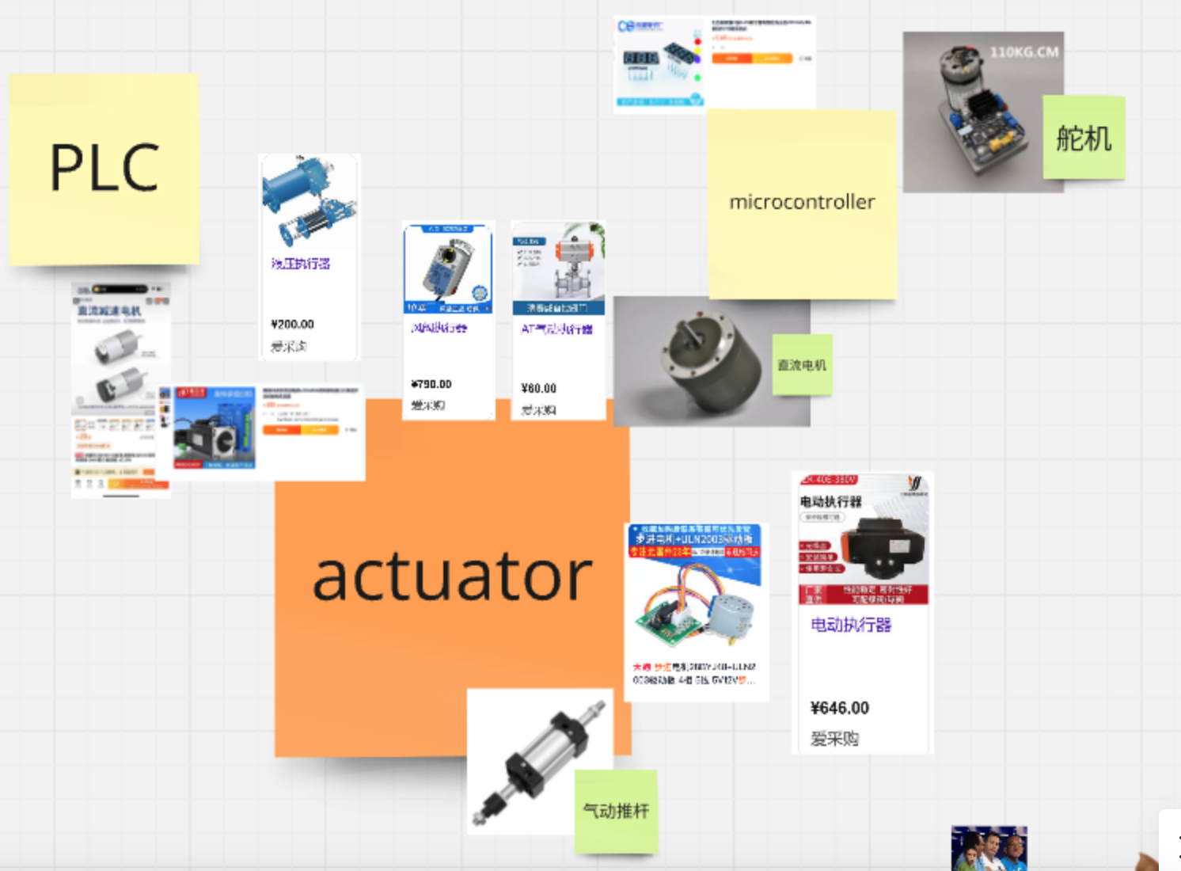

Slide 11
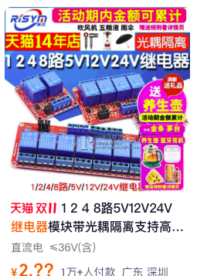
Exercise Conclusion
There are different types of sensors and actuators
Some of them are to in small voltages (3-5V) – meant to be connected to GPIO of microprocessors, Eg. Audrino, Raspberry Pi
Some of them are in bigger voltage (21V) – meant to be connected to PLC
You will burn the computer/processor if you connect the wrong type
You can use a Relay to convert the voltage

Slide 12
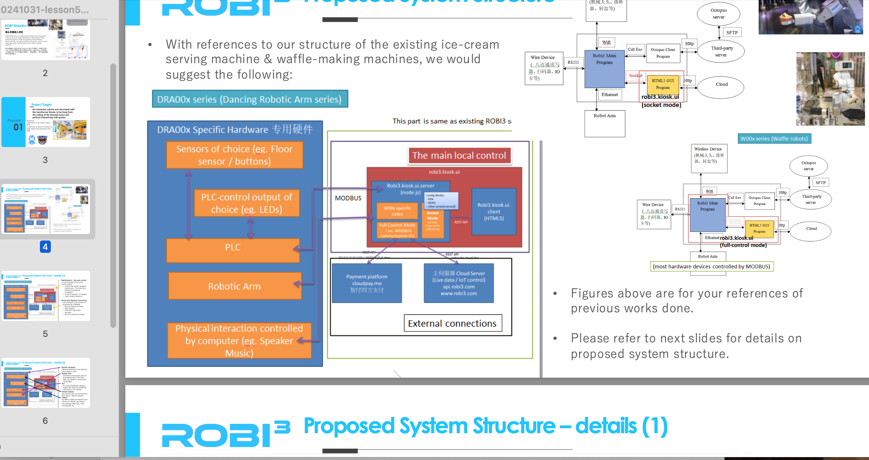
Note – there is no mid-term. This project (with an extension with the Waffle machine) is midterm
Please make sure you do it~~ We are spreading it into Please try not to skip the upcoming 3 classes so you will know how to do it

Slide 13
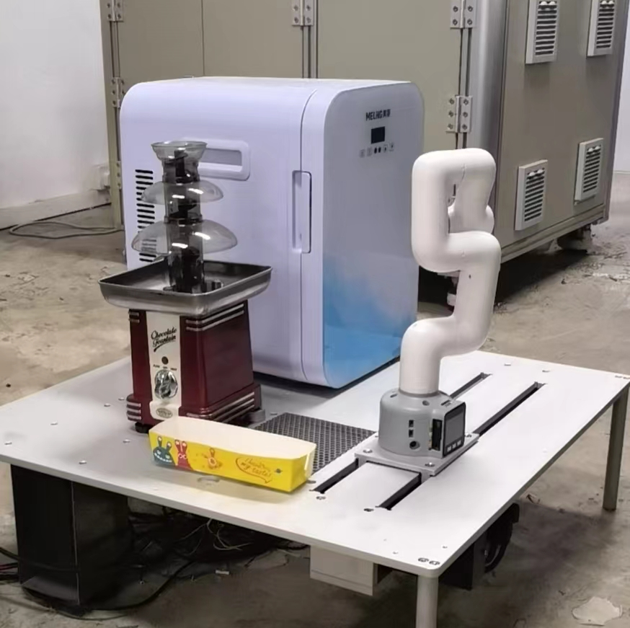
Writing the Block Diagram
About the Chocolate fountain robot
Download the Patent on the Chocolate Foundue Robot – and the draft out the block diagram
Note: the patent only tells you how it works, it doesn’t have details of each components, that is what we have to find out
(We will go back to the waffle machine after this… as that is way too complicated)

Slide 14
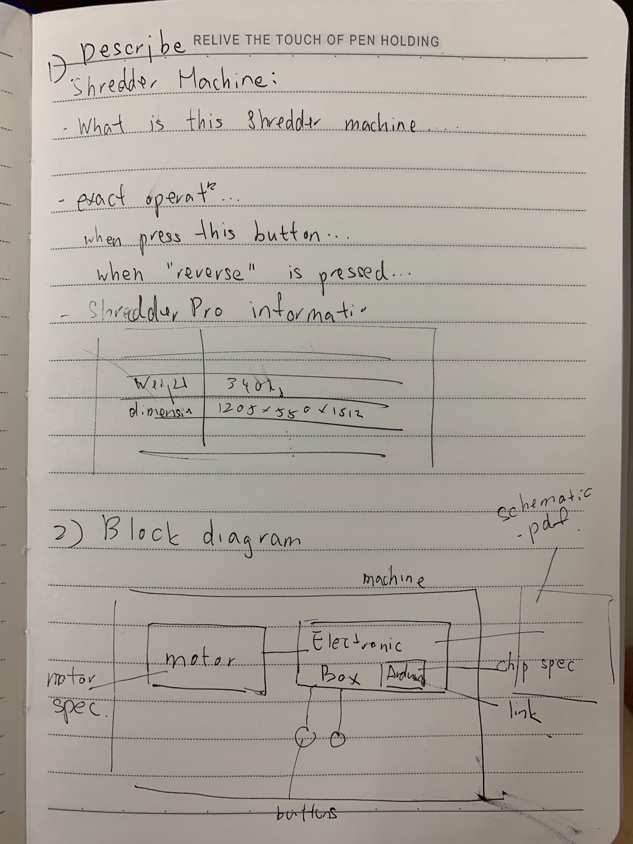
Work it out on your Miro board (1st part of lesson)
In group of 3-4 students, try drafting out the block diagram you see.

